Slide 1
Business Process Engineering
Week # 4
FALL-2025

Slide 2
Classification of Industries
Primary industries – cultivate and exploit natural resources
  Examples: agriculture, mining
Secondary industries – convert output of primary industries into products
  Examples: manufacturing, power generation, construction
Tertiary industries – service sector
  Examples: banking, education, government, legal services, retail trade, transportation

Slide 3
Manufacturing Industries
Food, beverages, tobacco
Textiles, apparel, leather and fur products
Wood and wood products, cork
Paper, printing, publishing, bookbinding
Chemicals, coal, petroleum, & their products
Ceramics, glass, mineral products
Basic metals, e.g., steel, aluminum
Fabricated products, e.g., cars, machines, etc.
Other products, e.g., jewelry, toys

Slide 4
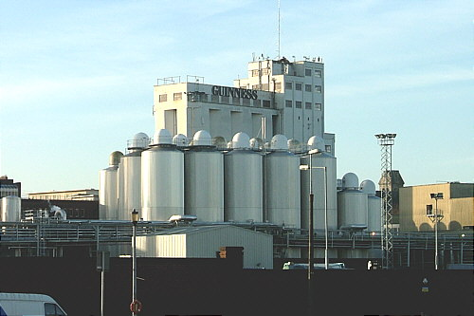
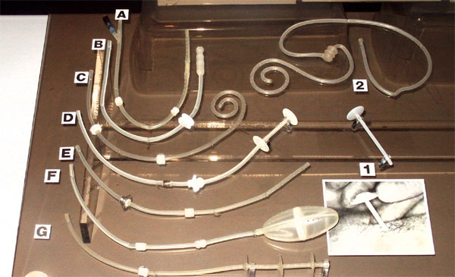
More Industry Classifications
Process industries, e.g., chemicals, petroleum, basic metals, foods and beverages, power generation
Discrete product (and part) industries, e.g., cars, aircraft, appliances, machinery, and their component parts

Slide 5
Manufacturing Process
Manufacturing involves making products from raw material by using various processes, by making use of hand tools, machinery or even computers
Manufacturing Engineering is the study of the processes required to make parts and to assemble them in machines
Process Engineering, applied in engineering industries, shows how the different problems related to development of various machines may be solved by a study of physical, chemical and other laws governing of manufacturing process

Slide 6
Manufacturing Operations
Transformation Operations
  Machine Processing
  Assembly
Adding value*
Other Operations
  Material handling
  Inspection and testing
  Coordination and control
Raw
Material
Part or
Product
Scrap or
Waste
Transformation Process
Power
Tools
Machines
Labour

Slide 7
Manufacturing Process Types
Manufacturing processes can be divided into two basic types:
Processing operations: transforms a work material from one state of completion to a more advanced state closer to the final desired product.
Assembly operations: joins two or more components in order to create a new entity called an assembly, subassembly, etc.
Adding value means changing geometry, properties or appearance of the starting material.

Slide 8
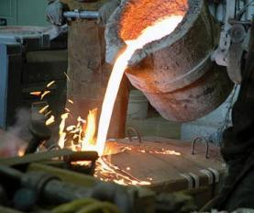
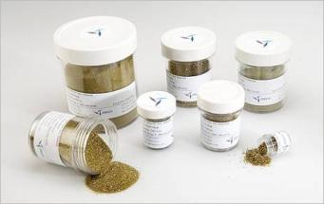
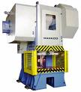
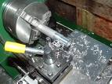

Processing Operations
Shaping operations
  Solidification processes
  Particulate processing
  Deformation processes
  Material removal processes
Property-enhancing operations (heat treatments)
Surface processing operations
  Cleaning and surface treatments
  Coating and thin-film deposition

Slide 9
Processing Operations
Processing operations use energy to alter a workpart’s shape, physical properties or appearance in order to add value to the material.
Shaping operations alter the geometry of the work material by methods including casting, forging and machining.
Property-enhancing operations add value to the material by improving its physical properties without changing its shape; e.g. Heat treatment.
Surface processing operations performed to clean, treat, coat or deposit material onto the exterior surface of the work. Examples for coating are plating and painting.

Slide 10
Shaping processes
Shaping processes change the geometry of a work material by application of heat or mechanical force or a combination of both.
Solidification processes: the starting material is a heated liquid or semifluid that cools or solidifies to form the part geometry.
Particulate processing: the starting material is a powder, and the powders are formed and heated into the desired geometry.
Deformation processes: the starting material is a ductile solid that is deformed to shape the part.
Material removal processes: the starting material is a solid, from which material is removed so that the resulting part has the desired geometry.

Slide 11
Property enhancing processes
Property enhancing processes are performed to improve mechanical or physical properties of the work material (no shape altering).
The most important processes involve heat treatments, which includes various annealing and strengthening processes for metals and ceramics.

Slide 12
Surface Processing Operations
Cleaning includes both chemical and mechanical processes to remove dirt, oil and other contaminants from the surface.
Coating and thin film deposition involves applying a coating of material to the exterior surface of the workpart, examples are painting (organic coating) and electroplating. Thin film deposition in the other hand include physical and chemical vapor deposition to form extremely thin coatings of various substances.

Slide 13
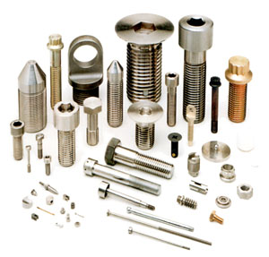

Assembly Operations
Joining processes
  Welding
  Brazing and soldering
  Adhesive bonding
Mechanical assembly
  Threaded fasteners (e.g., bolts and nuts, screws)
  Rivets
  Interference fits (e.g., press fitting, shrink fits)
  Other

Slide 14
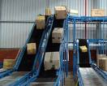
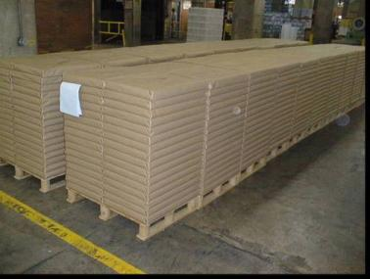
Material Handling
Material transport
  Vehicles, e.g., forklift trucks, AGVs, monorails
  Conveyors
  Hoists and cranes
Storage systems
Unitizing equipment
Automatic identification and data capture
  Bar codes
  RFID
  Other AIDC

Slide 15
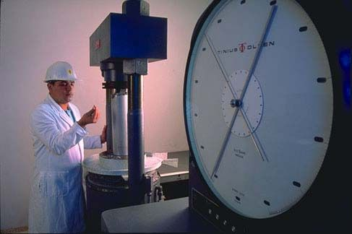

Inspection and Testing
Inspection – conformance to design specifications
  Inspection for variables
  Inspection of attributes
  Testing – observing the product (or part, material, subassembly) during operation

Slide 16
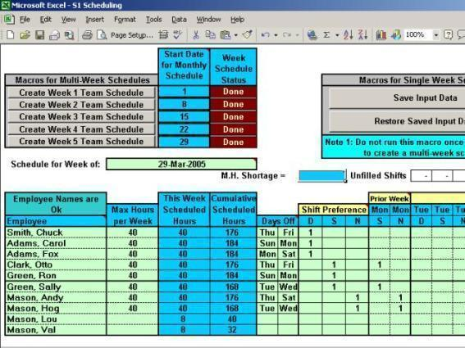
Coordination and Control
Regulation of the individual processing and assembly operations
  Process control
  Quality control
Management of plant level activities
  Production planning and control
  Quality control

Slide 17
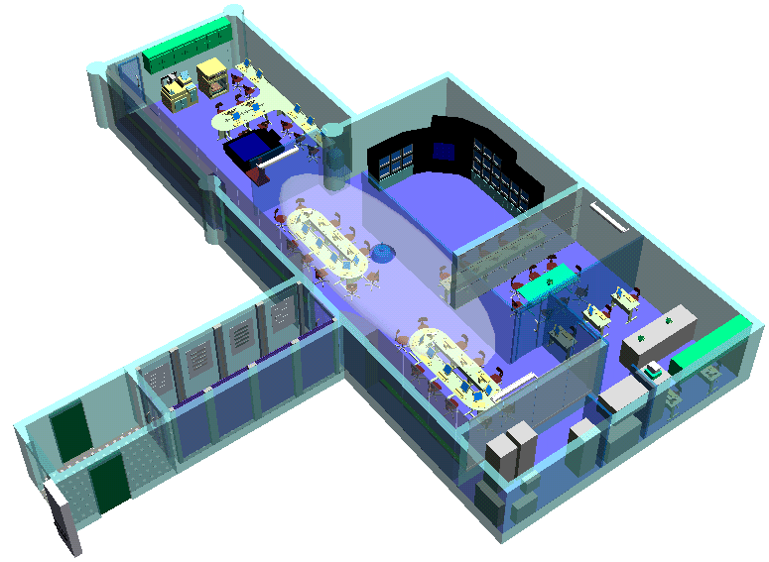
Production Facilities and Layout
Facilities organized in the most efficient way to serve the particular mission of the plant and depends on:
  Types of products manufactured
  Production quantity
  Product variety

Slide 18
Why to study Manufacturing Process?
Backbone of any industrialized nation
Today’s competitive manufacturing era is the age of automation and computer integrated manufacturing
Manufacturing/technical staff in industry must know:
  the various manufacturing processes
  materials being processed,
  tools and equipments for manufacturing different components or products
  optimal manufacturing process plan using proper precautions; and
  specified safety rules to avoid accidents.
Complete understanding of basic manufacturing processes is highly difficult for anyone to claim expertise over it

Slide 19
Why should you, as SE students, learn about Manufacturing Process ??

Slide 20
Production Process
The art of converting raw material into finished goods with application of different types of tools, equipments, machine tools, manufacturing set ups and manufacturing processes
Generally, there are 3 basic types of production systems:
  Job Production
  Batch Production
  Mass Production

Slide 21
Job Production
A single product is made at a time based on the requirements of the customer
Tends to be labour intensive, and often highly skilled labour is required
Examples include: building ships, bridges and buildings, handmade crafts like furniture and made-to-measure clothes
Advantages
Unique, high quality products are made
Workers are often more motivated and take pride in their work
Improves Customer Satisfaction
Disadvantages
Labour intensive with high selling price
Production takes a long time
Unit costs are very high

Slide 22
Can you think of another example of Job Production ??

Slide 23
Batch Production
Products are made in batches (200 – 800 in number)
Methods are suited to products that are identical to each other, but are only produced in limited quantities
Employees focus on one production aspect so labour is not usually highly skilled.
Example includes a shoe factory that makes different batches of shoes based on the size and colour.
Advantages
Unit costs are lower
Offers customer some variety
Production is flexible due to batches
Workers specialize in one process
Disadvantages
Workers are often de-motivated due to repetitive work
Goods have to be stored until they are sold
Initial set-up costs are high

Slide 24
Can you think of another example of Batch Production ??

Slide 25
Mass Production
Large number of identical products are made (say more than 50,000 in number)
Production is often continuous, and is suited to high demand, mass market products
Examples include cars, chocolate bars, electronic goods, etc.,
Advantages
Labour costs are usually lower
Materials can be purchased in large quantities, so they are often cheaper
Unit costs are relatively low
Disadvantages
Machinery is very expensive to buy with very expensive production lines
Workers do repetitive work
If one part of the production line breaks, the whole production process will stop

Slide 26
Can you think of another example of Mass Production ??

Slide 27
Role of:
  Man
  Machine
  Material
  Methods
  Money
  Infrastructure Facilities
in Manufacturing Process??

